Slide 1

Beer Reviews

Slide 2
Introduction
Evaluating beer reviews based on breakdown of more specific reviews of aroma, taste, palate, and appearance
Ho: There is no significant difference between overall review score and the review scores of the attributes.
Ha: There is a significant difference between overall review scores and the review scores of the attributes.
Also exploring a filtered data set by focusing on top 10 beers and top 15 breweries of those beers.

Slide 3
Data Analyzed
Over 1.5 million reviews evaluated
What attributes of a beer ARE MOST IMPORTANT

Slide 4

Focus:
To what degree are scores effected by ABV, aroma, appearance, taste, and palate.
Image: https://unsplash.com/photos/1MqDCpA-2hU

Slide 5
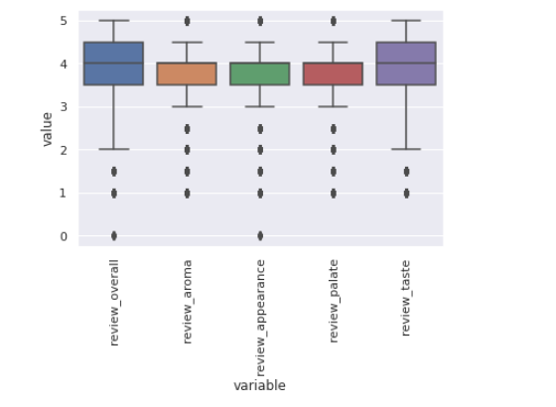
1. All Beer and Breweries
Using multiple regression, we see the effect of the different ratings using the following function:
score = 0.519 + 0.077(aroma) + 0.048(appearance) + 0.27(palate) + 0.55(taste) -0.042(abv)
With 95% confidence, we can also reject all null hypothesis that there is no significant difference between the scores.

Slide 6
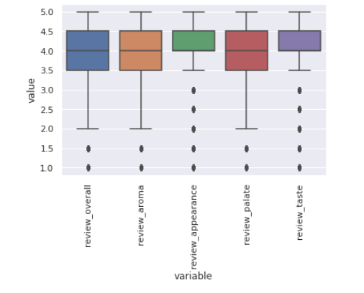
2. Top Beers and Breweries
Using multiple regression, we see the effect of the different ratings using the following function:
score = 0.432 + 0.066(aroma) + 0.066(appearance) + 0.26(palate) + 0.54(taste) -0.041(abv)
With 95% confidence, we can also reject all null hypothesis that there is no significant difference between the scores.

Slide 7
3. Comparing Results
Variables | All | Top
X-Intercept | 0.519 | 0.432
Aroma | 0.077 | 0.094
Appearance | 0.048 | 0.066
Palate | 0.27 | 0.26
Taste | 0.55 | 0.54
ABV | -0.042 | -0.041

Slide 8
Conclusion
The most important attributes to consider when making a beer is to consider the taste, as this has the most weight on overall score.
ABV has an interesting effect on overall score.

Slide 9

Questions?

